Slide 1
Lecture 11 – Data and instruction representation
2017.09.15
“The main problem in computer arithmetic is mapping from the human infinite number system to the finite representational capability of the machine.” Shlomo Wasser and Michael J. Flynn
Introduction to Arithmetic for Digital System Designers
1982

Slide 2
C code / processor instructions (pins) comparison
int main (void) …
{ …
int A; …..………….
int B; …..………….
printf( … ); ...
scanf( … ); …
printf( … ); …
scanf( … ); …
int C; …
C = A + B; …
printf( … ); …
} …
no processor instructions (npins): compiler, linker directive
npins: start delimiter for parsing C
npins: reserve a location and associate a data type
npins: reserve a location and associate a data type
many instructions (pins): command peripheral output device
many pins: convert given input to a specified operand type and place at reserved location
many pins: command peripheral output device
many pins: convert to type and place at reserved location
npins: reserve a location and associate a data type
one pin: address location A, read, send value to ALU; point to location B, read, send value to ALU; use opcode to select int adder combinatorial circuit within ALU and compute sum; finally write adder circuit output to location named by the letter C [all these words describe just one instruction]
many pins: command peripheral output device
npins: end delimiter for parsing C
Notes:
Instructions require many words to describe their action because every detail of that action must be specified in full detail.

Slide 3
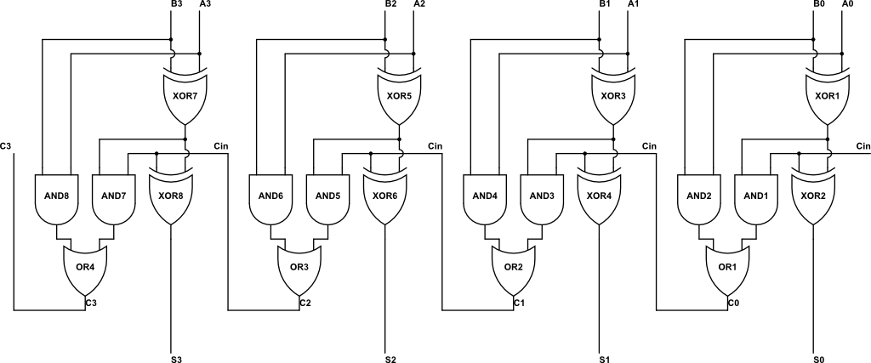
Selecting the combinatorial circuit for C = A + B
C = A + B; …use opcode to select combinatorial circuit of the integer adder
Data type of C, A, and B determine the correct circuit to use to add
Changing from 32-bit data to 64-bit data requires using a larger, different adder circuit
versus
Notes:
Examples: result(s) complex number math
A + B in a C program might be adding integers, might be adding floating point, cannot use same circuit, so the + in C will be translated to different instructions to the processor. The + is OVERLOADED.

Slide 4
Instruction set architecture (ISA)
Instruction set: set of operations that a processor performs
Each iteration of Fetch-Execute cycle fetches one instruction and executes it
Each instruction defines exactly the nature of its operand(s) and their acceptable values; defines all actions taken by the processor to execute the instruction and any error conditions because each instruction is representable by a truth table
Instruction representation, or instruction format
Instruction format defines how to interpret bit strings as instructions
Defines the format of each instruction and the interface between compiler/linker/loader and hardware

Slide 5
Binary Digit – bit, for short
Direct representation of digital logic values
Mathematical interpretation is 0 and 1
A sequence of bits, called a bit string, is used to represent a complex data item, for example:
character
integer
image
or a text or evs!
The bit string concept is a powerful representational platform

Slide 6
Binary digit strings
A single binary digit (bit) has one of two values
What about a string of bits?
Number of possible patterns of an n-bit string is 2*2*2 … *2 = 2^{n}

Slide 7
General bit strings
There are 2^{k} distinct strings of k bits
Example: all 3-bit strings 000 001 010 011 100 101 110 111
k bits can be carried on k wires
k bits can be stored in k flip-flops
k bits can represent 2^{k} values
k bits can name or point to 2^{k} locations
Notes:
Range is exponential in the number of wires

Slide 8
Powers of 2: the numbers of CS
Learn the powers of 2 from 2⁰ to 2⁴⁹
How?
Memorize decimal equivalents for 10 cases 2⁰, 2¹, 2², 2³, 2⁴, 2⁵, 2⁶, 2⁷, 2⁸, 2⁹ {1, 2, 4, 8, 16, 32, 64, 128, 256, 512}
Memorize names for 2¹⁰, 2²⁰, 2³⁰, 2⁴⁰ {Kilo, Mega, Giga, Tera } know in base 10 {~10³, ~10⁶, ~10⁹, ~10¹² } {thousand, million, billion, trillion}
Combine above and use decomposition to know 2³² bytes = 2^{2+30 bytes} = 2² * 2³⁰ bytes = 4 Gigabytes

Slide 9
What does a binary string mean?
A binary string means, or represents, whatever the circuit designer or the programmer says it does
A bit string has no meaning, until we choose the meaning
Common choices
Numbers, characters, files, status of peripheral devices
… many, many more possibilities

Slide 10
Example: a UNIX file
UNIX views a file as a sequence of bytes
Byte = 8-bit binary string
For most computers, byte is the smallest unit of information directly accessible from storage
Let’s “look at” the bytes of a mystery file
Notes:
Showed a file of the Purdue logo at this point in the lecture, as it is interpreted by various “viewing” programs: more, od, xxd, and Apple Preview

Slide 11
Show a file of the Purdue logo as it is interpreted by various “viewing” programs: more, od, xxd, and Preview.app (Apple)

Slide 12
Using binary strings to represent information
Binary strings will encode both program instructions and data
Designing representations, or formats, or encodings is done all the time
Write a program using a struct
Some representational schemes are encoded directly into the logic of computational circuits, such as adders
Encoding should not be arbitrary: design the encoding to satisfy goals and criteria

Slide 13
Hexadecimal notation, hex for short
16 , 2⁴, hexadecimal digits 0,1,2,3,4,5,6,7,8,9,A,B,C,D,E,F
One hex digit encodes 4 bits
Shorter, easier to write long bit strings in hex
Example
DEC49 encodes the bit string 1101 1110 1100 0100 1001 D E C 4 9
Practice converting between hex and binary

Slide 14
Binary strings representing characters
Started with Baudot Code (1870)
5 bits/character, so a total of 2⁵ = 32 characters
Roman letters, punctuation, control signals
typed on a 5-piano-key keyboard using two left hand fingers and three right hand fingers
character encodings were chosen to minimize keyboard operator fatigue
became International Telegraph Alphabet No. 1
1901, Donald Murray modifies Baudot
Introduces CR, LF, and re-encodes NULL, DEL
Used by Western Union teletype machines until 1950s (tele = at a distance; type = write)
Notes:
Tele-vision
Tele-phone
How do you move your bags when checking for the fall semester at Starfleet Academy? Tele-porter

Slide 15
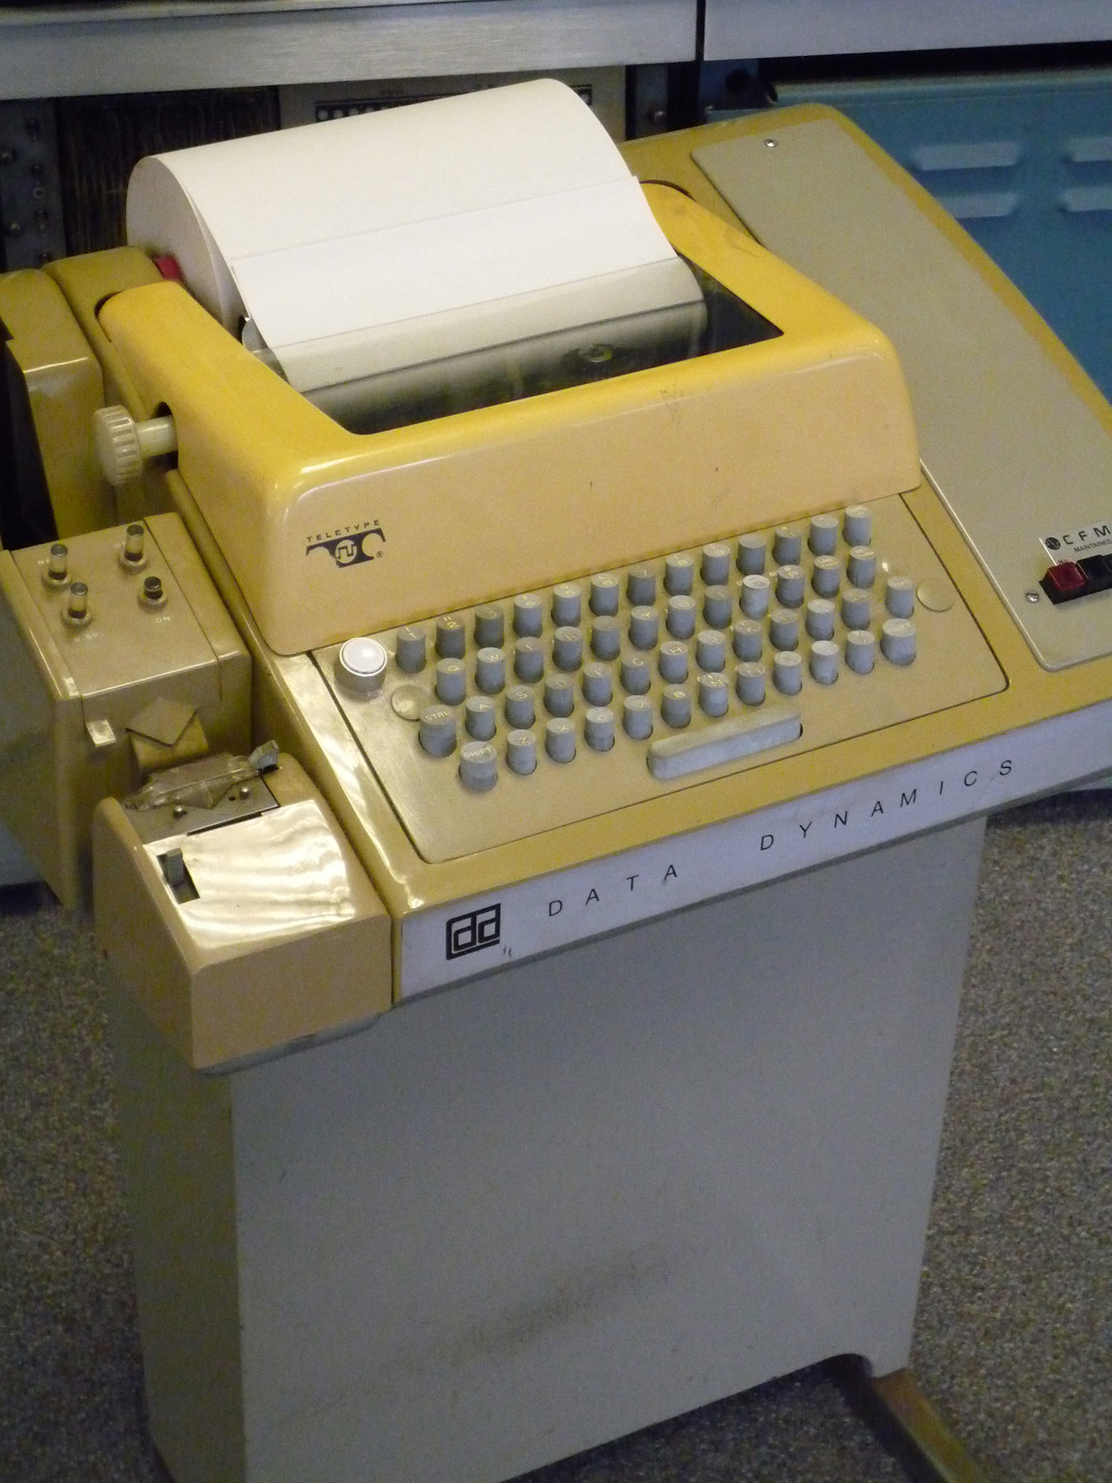
"Teletype with paper tape punch and reader" by AlisonW - Own work. Licensed under Creative Commons Attribution-Share Alike 3.0 via Wikimedia Commons
http://commons.wikimedia.org/wiki/File:Teletype_with_papertape_punch_and_reader.jpg
#mediaviewer/File:Teletype_with_papertape_punch_and_reader.jpg
Notes:
Character sets contain traces of truly ancient computing and communication history.
The first time I sent a program to a computer (summer after junior year in high school) I used a Teletype machine like this.

Slide 16
ASCII character representation
1963, American Standard Code for Information Interchange (ASCII) 7-bit code, so 2⁷ = 128 characters
Compared to Baudot/Murray
Adds: characters for digits 0 through 9, both letter cases, and many new control characters
Character encoding re-designed to
Make sorting text easier: alphabetic order = integer order of character codes
Simplify case-insensitive character matching and the logic circuit for keyboards/printers: upper case and lower case codes for a given letter differ only in leftmost bit position

Slide 17
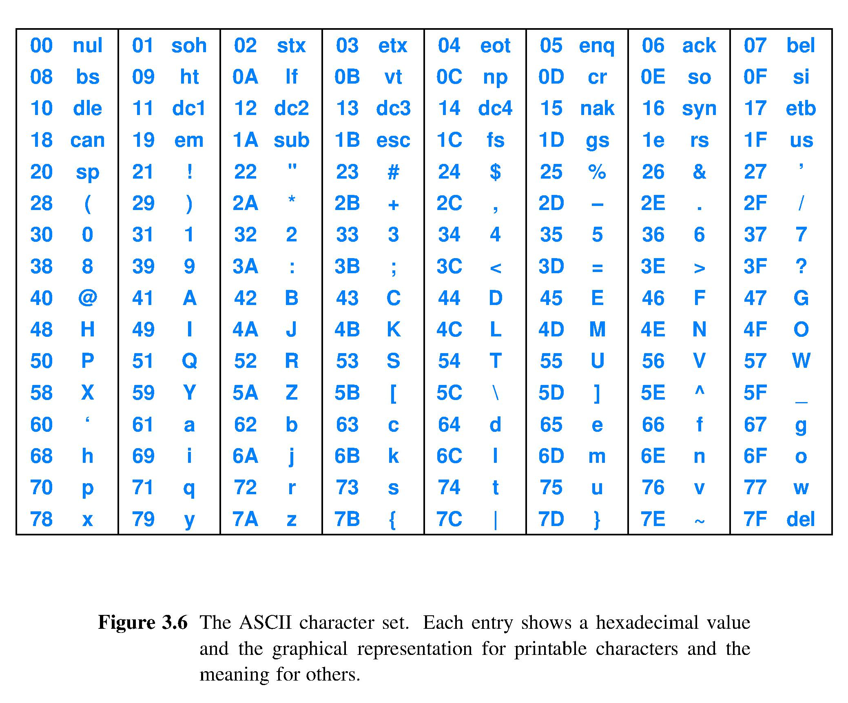
Upper and lower cases intentionally differ by 20
07 and 0A are examples of control characters

Slide 18
Other character representations
EBCDIC – Extended, Binary Coded Decimal, Interchange Code
8-bit code for IBM System/360 computers, 1963
Sorts letters before numbers and lowercase before uppercase; opposite of ASCII
Unicode – world standard, version 10.0 current as of June 2017
Up to 4 bytes per character, thus capable of 2³² = 4,294,967,296 characters
Today, 136,755 characters from 139 modern and historic scripts, and multiple symbol sets including emoji
😀 !

Slide 19
Number representation schemes
There are stunningly many different ways to represent numbers
We will cover the most widely used weighted positional systems in computers
Number representation schemes are designed to have desirable characteristics
Want fast negation? You can have it
Want one circuit that both adds and subtracts? OK
Want to never have carry bits? Can do
What do you want from your number representation?

Slide 20
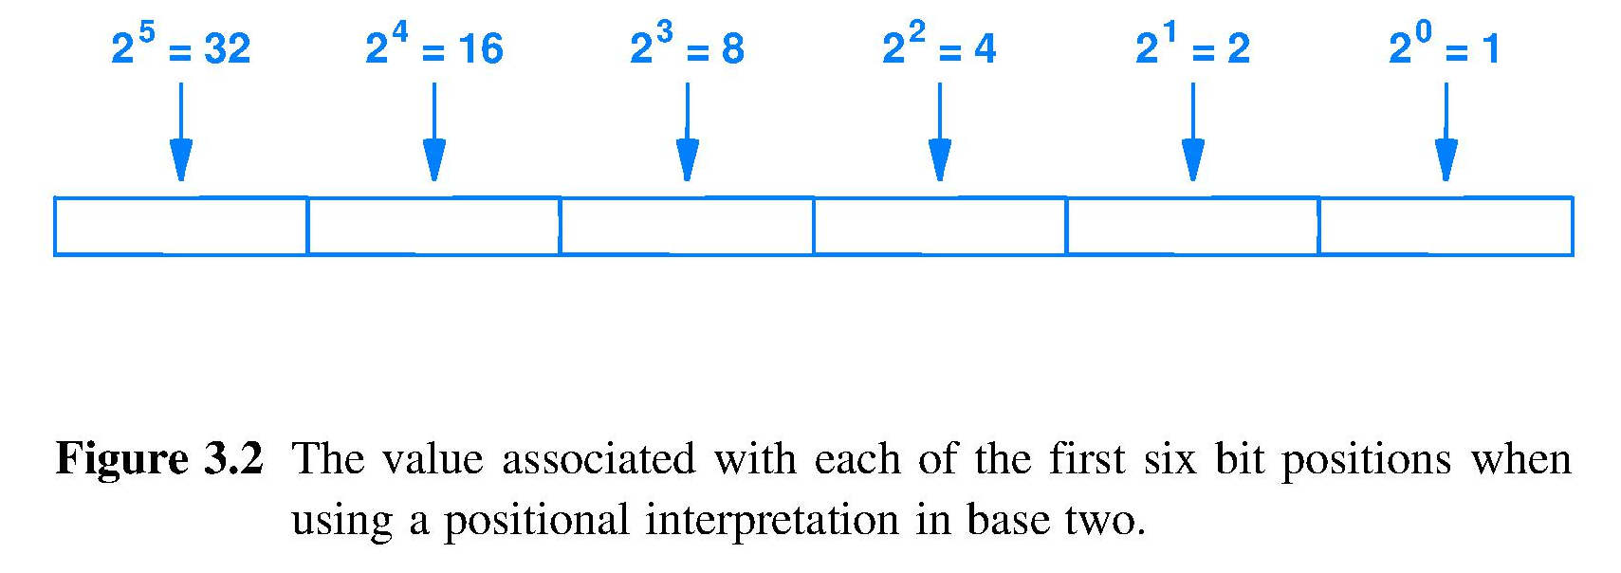
The binary weighted positional system
– Binary representation chosen to match binary logic circuits
– Weighted-positional system chosen so number of digits is ⌈ log₂ |number| ⌉ , ceiling of logarithm of number magnitude
Most significant bit (MSB)
Least significant bit (LSB)
0 0 1 0 1 1 is interpreted as 0x2⁵+0x2⁴+1x2³+0x2²+1x2¹+1x2⁰= 11

Slide 21
Weighted positional forms for CS250
Our focus is these weighted positional forms
Unsigned: binary digits interpreted as binary digits; only can represent positive integers
Signed: one or more digits represent a + or – sign
Sign-magnitude: leftmost digit is an explicit sign
1’s complement
2’s complement (also called radix complement)
BCD: encodes decimal digits to support decimal math
IEEE floating point: for scientific calculation

Slide 22
Unsigned integer
Straightforward use of binary weighted positional notation
No sign, so only non-negative integers
n bits can represent integers 0 through 2^{n}-1
Uses of unsigned integer representation
Encode the value of an address used by a decoder to point
Operands involved in pointer arithmetic
Essential for a processor to have unsigned add/subtract instructions

Slide 23
Sign magnitude integers
Leftmost bit represents sign: 0=+ and 1=–
Remaining bits represent magnitude of the integer using the weighted positional system
Quirk: has +zero and –zero representations
For 8-bit representation, quirk looks like 00000000 = +0 10000000 = -0 ^ sign bit

Slide 24
How does a designer choose a number representation?
Answer: Asks how well number system supports desired computations
Example: What mathematical operations does sign magnitude make easy?
Negation [ just invert the sign bit, leave magnitude unchanged]
|X| [ just reset sign bit of number to 0 to get absolute value]
Convert to representation using larger number of bits, e.g. 32 to 64 [ just insert needed number of zeros between magnitude and sign]
What mathematical operations are not easy with sign magnitude?
Comparison of two numbers for <, >, = Because there are two zeros, hardware must handle the special cases of -0 = +0 so a negative number is not simply less than a positive number; truth table requires a more complex circuit
Addition and Subtraction [because operand magnitudes [point 1) again] must be compared to compute sign of the result]
So, would you choose sign magnitude?

Slide 25
2017.09.13 Quiz question
I think sign-magnitude is the number system representation used in my computer for integers.
True
False

Slide 26
One’s complement integers
Positive integers use weighted positional
Negative integers formed by inverting all bits of the corresponding positive value
Example in 4 bits
0010 represents +2
1101 represents -2; leftmost bit usable as sign
Quirk: 0000 and 1111 represent +0 and -0
Checksum for internet packet headers in IPv4 is encoded using 1’s complement

Slide 27
–
}
(Interpretation written in sign magnitude decimal notation)

